Slide 1

Real Estate Market
Covid-19
Authours:
Emilia Lubanska, Jorge Arriola, Marina Ercoli, Monica Lin, Ulisses Pinto

Slide 2
Motivation & Summary
Curiosity
To analyse the impact of Covid-19 on the real estate market comparing 2019 and 2020 data from GTA.
Exam correlations, changes on interest rates as well as prices fluctuations sorting by types of houses/properties.
Questions & Why
What is the impact of Covid-19 on the real estate market?
Does it impact the interest rates?
Is there any correlation between Covid-19 and the volume of sales?
What types of the houses being sold (condo, detached etc.)
What about price fluctuation?

Slide 3
Motivation & Summary
Outcomes
……..
Core message & Hypothesis
CM: To analyze the impact of Covid-19 on the real estate market in Ontario.
Hypothesis: We believe that indicators related to the real estate market will have a lower performance in 2020 than in 2019. (e.g. less houses sold in 2020 than in 2019)

Slide 4

Questions & Data
Questions
Number of Covid-19 cases
Number of Covid-19 cases
Fluctuation of house price
Number of houses sold in Ontario per month
Interest rate fluctuation
Covid-19 cases Vs. interest rate
Covid-19 cases Vs. house sold
Covid-19 cases Vs. house price
Data Sources
Websites:
open.canada.ca ----- CSV
data.ontario.ca ----- JSON
quandl.com ---------- API
bankofcanada.ca ---- CSV

Slide 5
Questions & Data
Data Sources
Canada Mortgage and Housing Corporation, absorptions and unabsorbed inventory, newly completed dwellings, by type of dwelling unit in census agglomerations of 50,000 and over
https://open.canada.ca/data/en/dataset/1d329dea-af4a-4835-b524-06e329b4ff72
Canada Mortgage and Housing Corporation, housing under construction in all centres 10,000 and over for Canada, provinces, and selected census metropolitan areas https://open.canada.ca/data/en/dataset/1995a476-68fd-4fe2-973f-2dd47f7f6c2c
Confirmed positive cases of COVID19 in Ontario
https://data.ontario.ca/dataset/confirmed-positive-cases-of-covid-19-in-ontario/resource/455fd63b-603d-4608-8216-7d8647f43350
Average, Median and Price Percentiles for Unabsorbed Homeowner and Condominium Units (Provinces) – Ontario
https://www.quandl.com/data/CMHC-Canadian-Mortgage-and-Housing-Corporation/documentation?anchor=about
Canadian Interest Rates and Monetary Policy Variables: 10-Year Lookup
https://www.bankofcanada.ca/rates/interest-rates/canadian-interest-rates/

Slide 6
Data Cleanup & Exploration
Cleanup process
Based on the main data frame, create a new chart that only includes the information we need
Retrieve Data
Create data frames
Note: We all agreed to create a column named ‘Date’ with the same format for all datasets. Allowing us to grouping the datasets easily.

Slide 7
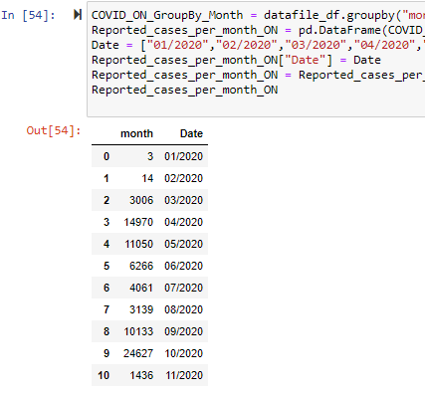
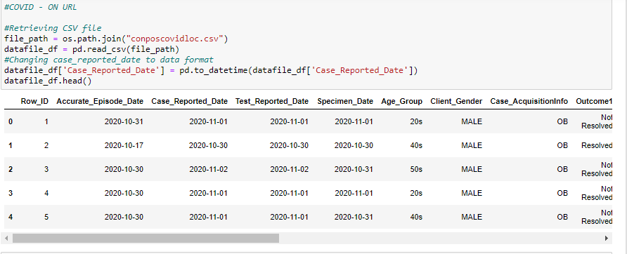
Data Cleanup
Before
Now

Slide 8
Data Cleanup & Exploration
Exploration
1st Step > We leveraged some sources provided by the government and banking institutions: - Open.canada.ca
- Data.ontario.ca
- Bank of Canada
2nd Step > It was to find a dataset that kept track of how the value of houses in Toronto has fluctuated in time.

Slide 9
Exploration
Insights while exploring the data that you didn't anticipate:
Insights > From a visual inspection, we noticed that the number of buildings being constructed in Ontario in 2019 and 2020 were very similar. Hence, Covid-19 did not seem to have a direct impact on this
Problems that arose after exploring data | How we solve them:
Problems >

Slide 10
Exploration
Interesting figures developed during exploration:
Final Jupyter Notebook
Figures Summary

Slide 11
Data Analysis
Steps to analyze the data and answer proposal questions:
………
……….
Interesting figures developed during analysis :
Final Jupyter Notebook

Slide 12
Discussion
Findings:
………
……….
Inferences | General conclusions:
………
……….

Slide 13
Discussion
Findings:
………
……….
Inferences | General conclusions:
………
……….

Slide 14

Post Mortem
Difficulties that arose, and how we dealt with them:
………
……….
Additional questions | What would we research next?
………
……….

Slide 15

Q&A with the audience

Slide 16
Thank You!
Our photo to be added
Covid-19
Emilia Lubanska, Jorge Arriola, Marina Ercoli, Monica Lin, Ulisses Pinto

